Slide 1

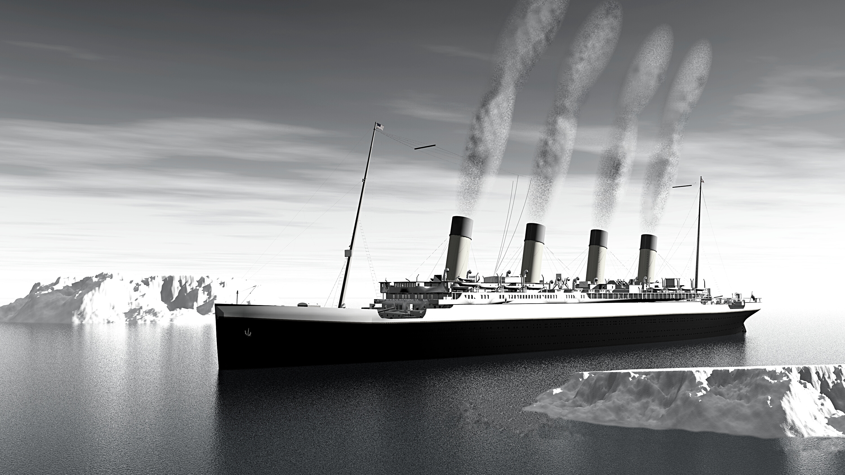

Titanic - Machine Learning from Disaster
By Zhelu Mai and Lilian Hall
Group 1 - BCIS 5100 Final Project
Notes:
Hello everyone, we're group 1, Jerry and Lilian. I'll start of and Jerry will conclude our presentation.
Our topic is about the Titanic dataset - Machine Learning from Disaster.

Slide 2
Presentation Agenda
Key topics for discussion
01
02
03
04
05
06
Motivation
Data Description
Data Exploration
Data Cleaning
Data Modeling
Conclusion
Notes:
Here's our topic of discussion in this presentation.

Slide 3
Purpose
This dataset is based on the infamous shipwreck of the Titanic which sank in the middle of the Atlantic on April 15, 1912. With a combination of factors such as icy cold waters, insufficient life boats, and other failures led in the death of 1,502 out of 2,224 passengers and crews.
Using exploratory data analysis through visualization, we will show which group of people more likely survived this infamous shipwreck based on their attributes using the Titanic dataset from Kaggle. As for the model building, we used two models to test out our dataset and showed which returned the best accuracy score.

Slide 4
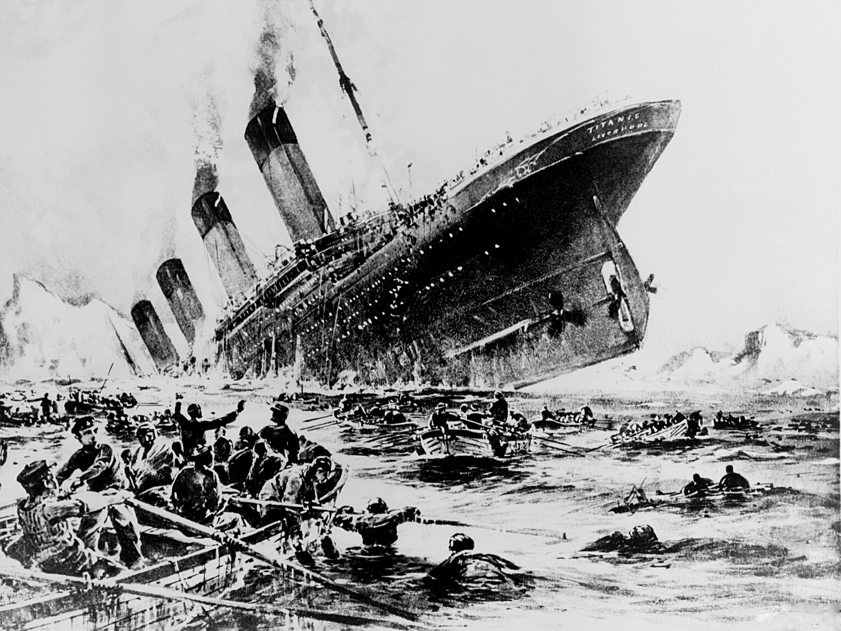
Motivation
To find out the answers to the following questions:
What group of people most likely survived the shipwreck?
Is the Titanic movie as chivalrous as depicted in the movie?
Notes:
Our motivation for choosing this particular dataset is to explore what group of people most likely survived this disaster.
Is the Titanic movie as chivalrous as depicted in the movie? We shall see.

Slide 5
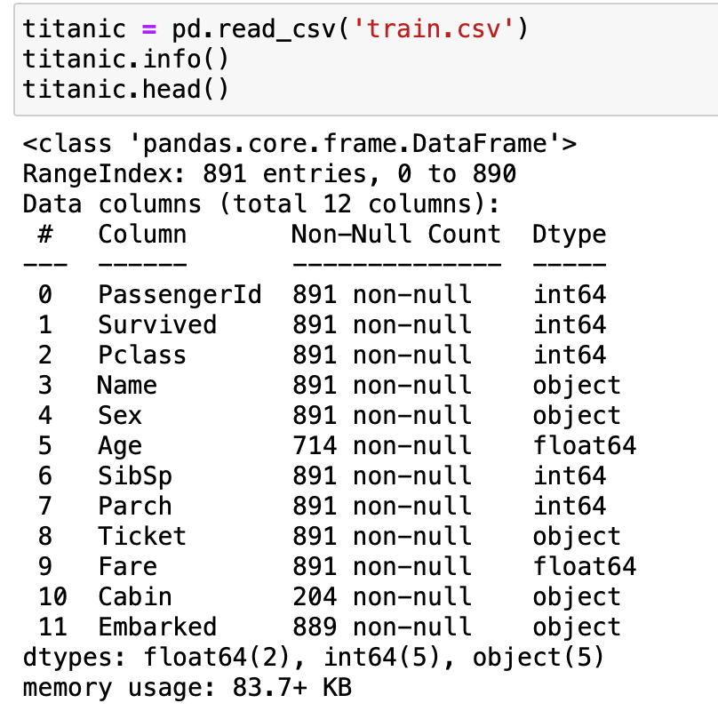
The data
The data provides 891 passengers (the training data) including if they survived or not
There are 12 columns or categories
PassengerId, Survived, Pclass, Name, Sex, Age, SibSp(Sibling, Spouse), Parch(Parent & Children), Ticket, Fare, Cabin, and Embarked
Pclass = "1st, 2nd, 3rd class" cabins.
SibSP = "Sibling" (brother, sister, stepbrother, stepsister) and "Spouse" (husband, wife).
Parch = "Parent" (mother, father) and "Child" (daughter, son, stepdaughter, stepson)
Notes:
The data provided us with 891 entries and we have 12 different categories or columns, and each row contains the information for each passenger. Lets dig into what this categories are: PassengerID - is the ID of the passenger, Survived, shows whether this person survived or not, Pclass stands for the Cabin class:1st, 2nd or 3 rd class. SibSp ( Stands for Sibling or spouse), Parch stands for Parent or children, Ticket shows the ticket #, Fare – how much they paid for the ticket, Cabin shows the cabin # or location and embarked is the place of embarkation.

Slide 6
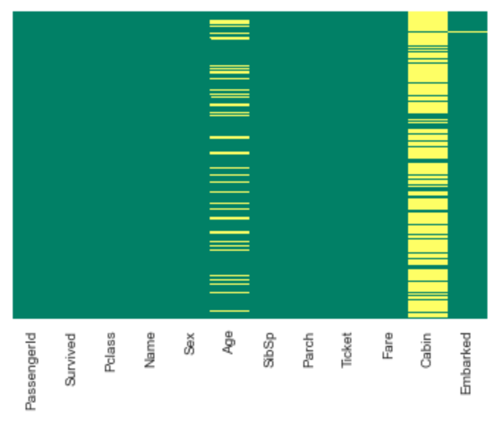
Data Exploration through Visualization
To find out if there are any missing data, we used a heatmap to visually see this.
This heatmap shows that the Age column is missing some data, the Cabin column looks like it is missing too much data, and embarked column is missing one row of data.
Notes:
Let’s explore this data set through visualization. We used a heatmap to show our missing data. As you can see, the ’Age’ column is missing about 20% the data, while the ’Cabin’ column looks like it is missing too much data, and the ‘Embarked’ column is missing one row of data.

Slide 7
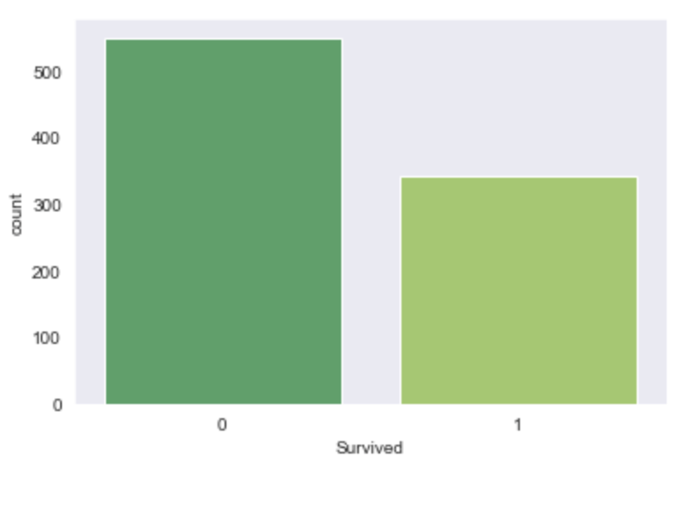
Data Exploration through Visualization
Deceased vs Survived Passengers
This graph shows the number of people that died was more than the ones who survived.
Deceased
Survived
Notes:
This graph shows the ratio between those who died and those that survived. We can see that those who survived are half of those that died.

Slide 8
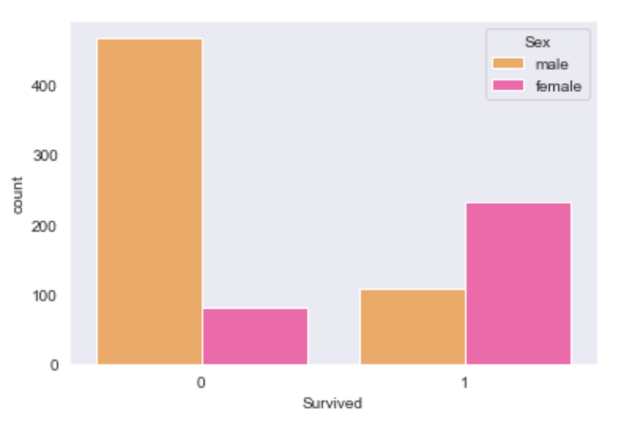
Data Exploration through Visualization
Male vs Female Passengers
This graph shows a trend that most of those who did not survive were most likely male while those who survived are twice more likely to be female.
Deceased
Survived
Notes:
This graph shows a trend that most of those who did not survive were most likely male while those who survived are twice more likely to be female.

Slide 9
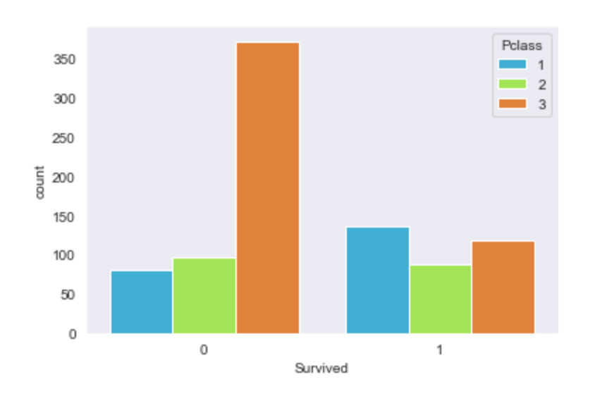
Data Exploration through Visualization
Cabin Classes: 1st Class, 2nd Class, & 3rd Class
The people who did not survive were overwhelmingly part of the 3rd class or the lowest class while most of those who survived were leaning towards the higher class or 1st class.
Deceased
Survived
Notes:
This graph shows the different type of cabin classes: 1st, 2nd, and 3rd class. The people who did not survive were overwhelmingly part of the 3rd class or the lowest class while most of those who survived were leaning towards the higher class or 1st class.

Slide 10
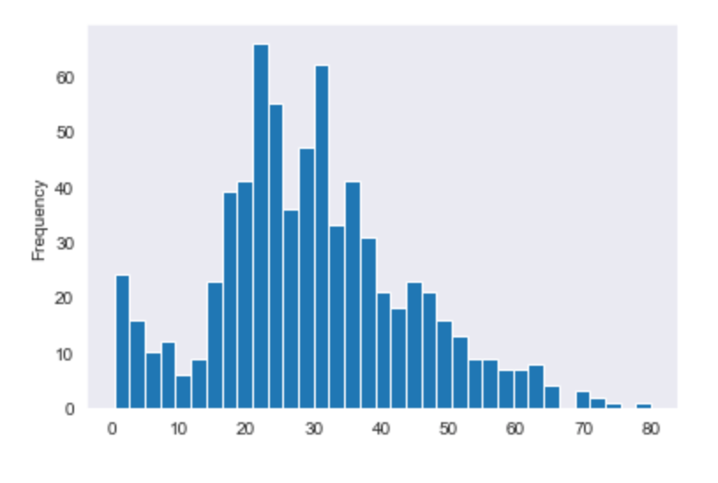
Data Exploration through Visualization
What are the Ages of Passengers ?
There are quite a few children from 0 to 10 years old and then there's a skewed pattern more toward the younger passengers ages 20-30 years old.
Notes:
This graph shows the distribution of the different age groups of the titanic passengers. We can see that there are quite a few children from 0 to 10 years old and then there's a skewed pattern more toward the younger passengers ages 20-30 years old.

Slide 11
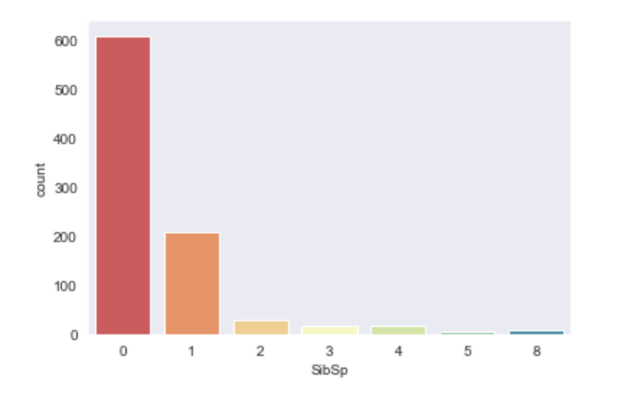
Data Exploration through Visualization
Did the passengers have Sibling/Spouses on board?
We can immediately tell that most of the passengers on board did not have children or spouses onboard, most were single.
Sibling/Spouses
Notes:
With this graph , we can immediately tell that most of the passengers on board did not have children or spouses onboard, most were single. Which makes sece most of the passengers were young from ages 20-30 years of age.

Slide 12
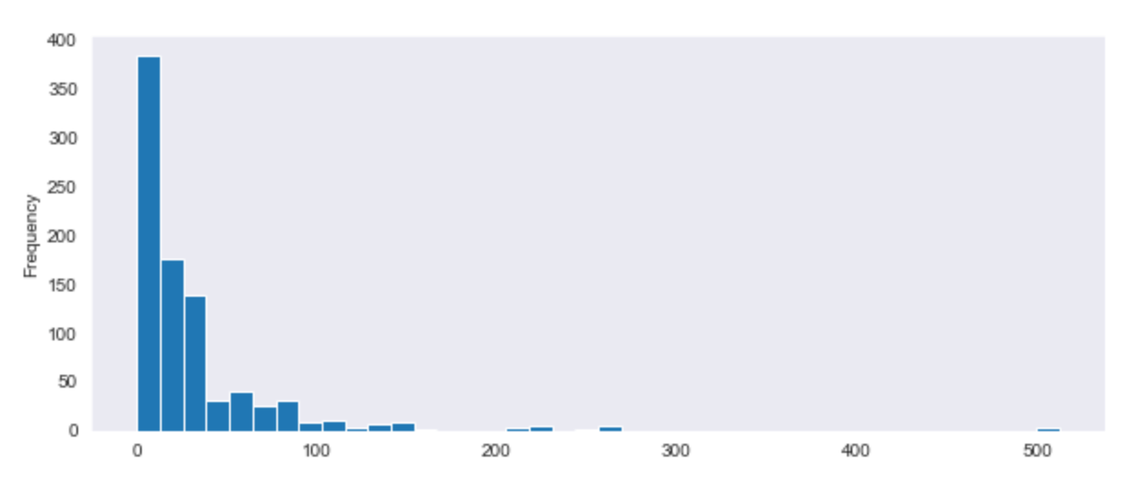
Data Exploration through Visualization
Fare prices
Most of the purchase prices are between 0 to 50 towards the cheaper fare tickets because most of the passengers were in third class.
Deceased
Survived
Notes:
This graph validates the graph from the previous slide because most of the passengers were young and single, it makes sense that most of the fare purchase prices are between 0 to 50 dollars towards the cheaper fare tickets since most of the passengers were in 3rd class.

Slide 13
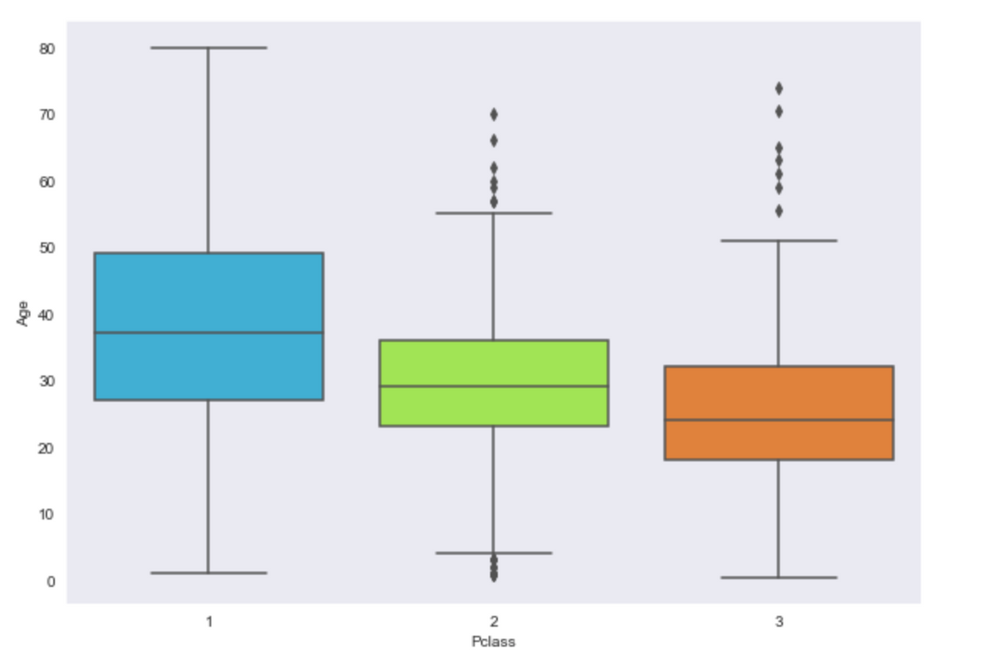
Data Exploration through Visualization
Age vs Cabin Class
This graph shows that the wealthier passengers in the first and second class tend to be older than the passengers in the third class.
1st Class
2nd Class
3rd Class
Notes:
This graph shows that the wealthier passengers in the first and second class tend to be older from ages 25-50 than the passengers in the third class, ages 20-30.

Slide 14
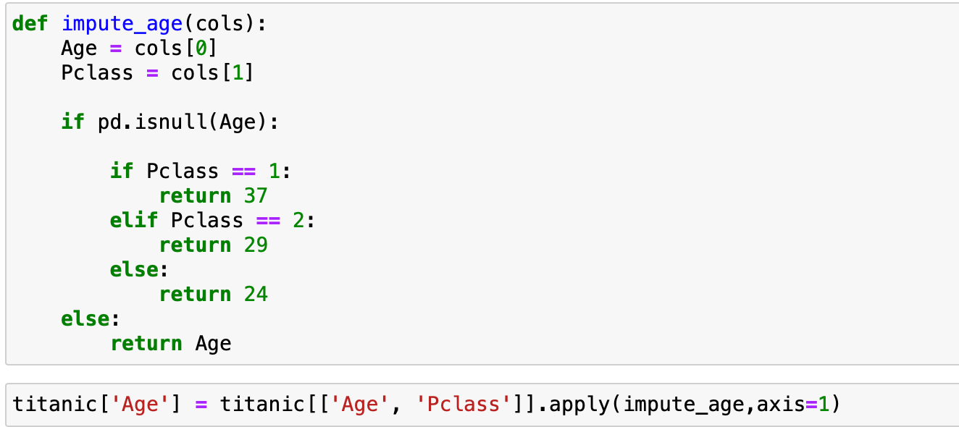

Data Preparation - Cleaning
01
We want to fill in missing data for the ‘Age’ column instead of just dropping the missing ‘Age’ data rows.
Using this graph on the left to get the mean age and code as follows:
02
03
Notes:
Hi, my name is Jerry and I’ll talking about our preparing and cleaning up our dataset. As we’ve seen at the outset, we have are missing some data. We wan to fill in missing data for the ‘Age’ column instead of just dropping the missing ‘Age’ data rows. We did this by getting the mean of the ages in the three classes: 1st, 2nd and 3rd class.

Slide 15
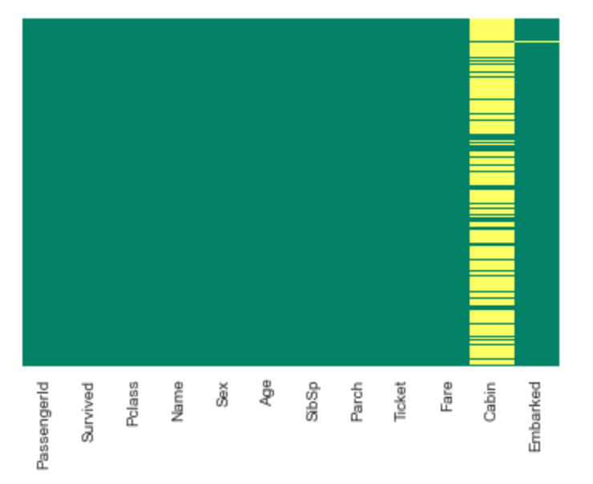
Data Preparation - Cleaning
02
Now we no longer have missing data on the "Age" column as shown in the heatmap below.
On the other hand, the Cabin column is missing too much data and so it makes sense to drop it.
Notes:
Now we no longer have missing data on the "Age" column as shown in the heatmap below. On the other hand, the Cabin column is missing too much data and so it makes sense to drop it.

Slide 16
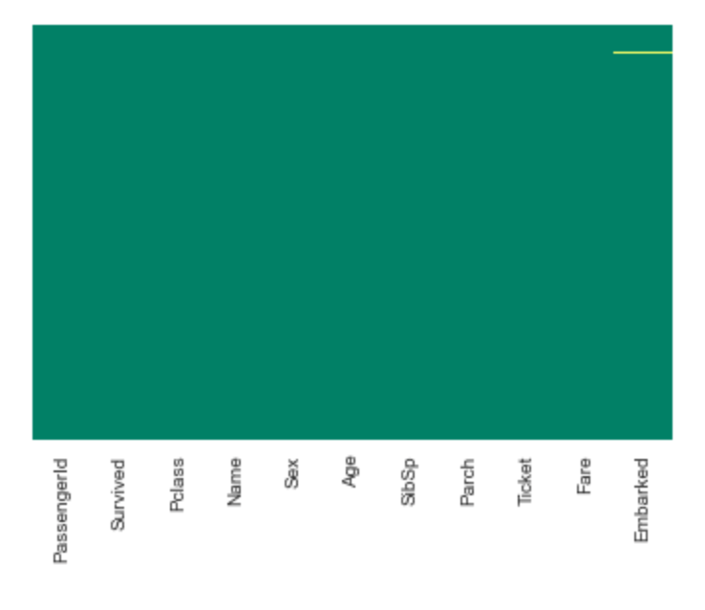
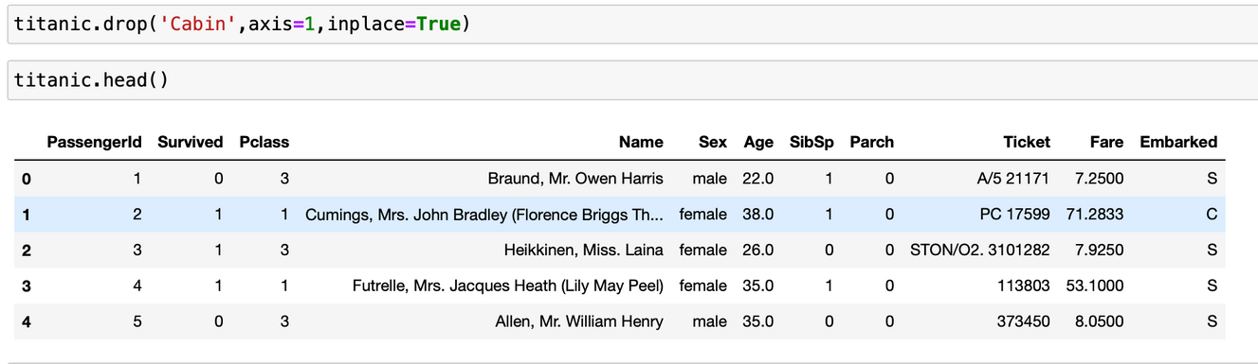
Data Preparation - Cleaning
03
Here's what it looks like after we drop "Cabin" column.
Now, we're just missing a value at the "Embarked" column.
Notes:
Here's what it looks like after we drop "Cabin" column. Now, we're just missing a value at the "Embarked" column.

Slide 17
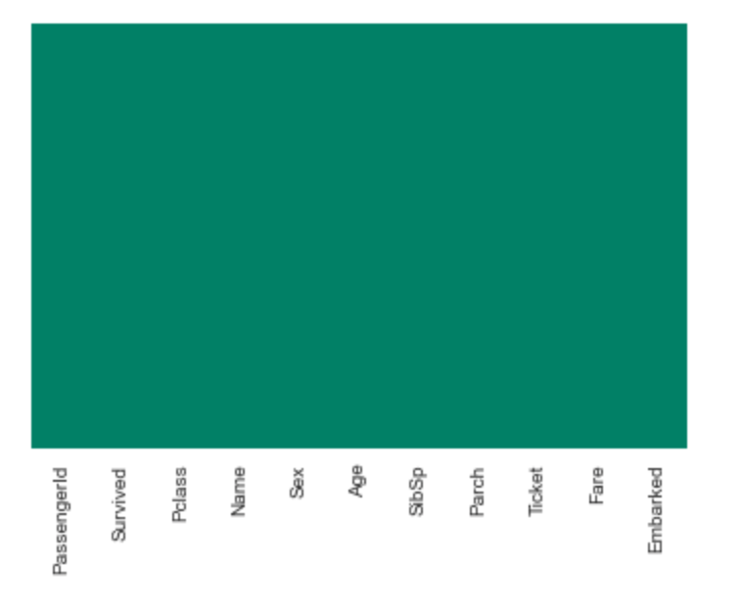
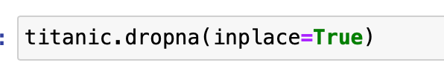
Data Preparation - Cleaning
04
Our heatmap shows we have no missing values.
Notes:
Now, as you can see with the heatmap we have no missing values.

Slide 18
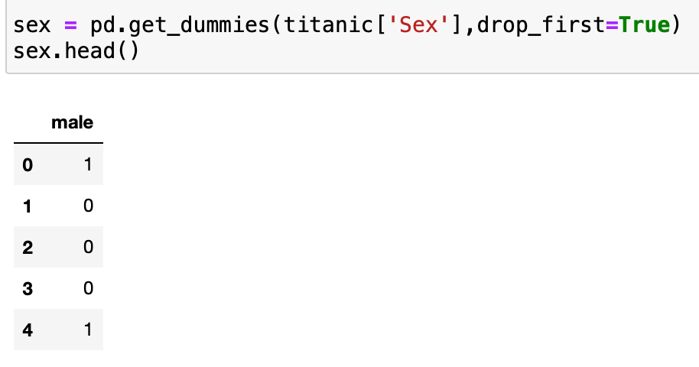
Data Preparation - Cleaning
05
Converting categorical features into dummy variables
So, we're going to prepare the 'Sex'column into a machine learning algorithm column
Notes:
We now have to convert categorical features into dummy variables by preparing the ‘Sex’ column into a machine learning algorithm column.

Slide 19
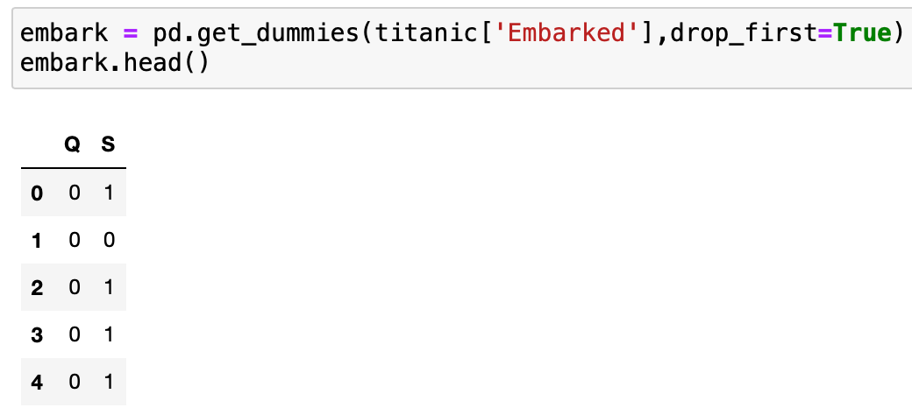
Data Preparation - Cleaning
06
Converting categorical features into dummy variables
We're going to do the
same for the 'Embarked' column
Notes:
We're going to do the same for the 'Embarked' column

Slide 20
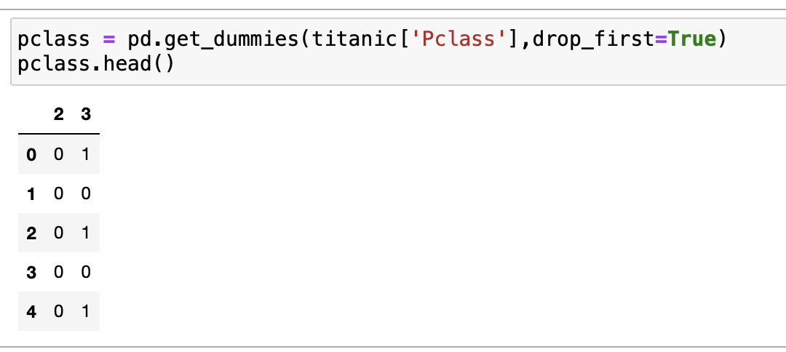
Data Preparation - Cleaning
06
Converting categorical features into dummy variables
We're going to do the
same for the 'Pclass’ column
Notes:
We're going to do the same for the 'Pclass’ column

Slide 21
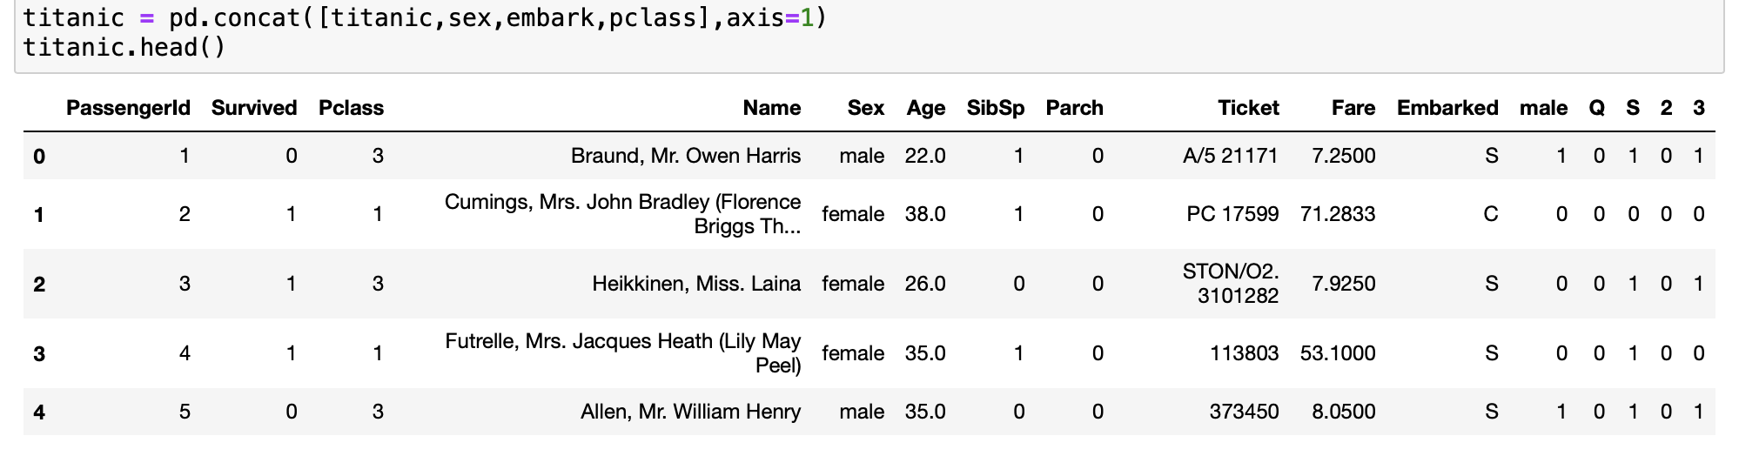
Data Preparation - Cleaning
07
Add the new columns to our dataframe
Notes:
Then add all the new columns or concatenate to our dataframe.

Slide 22
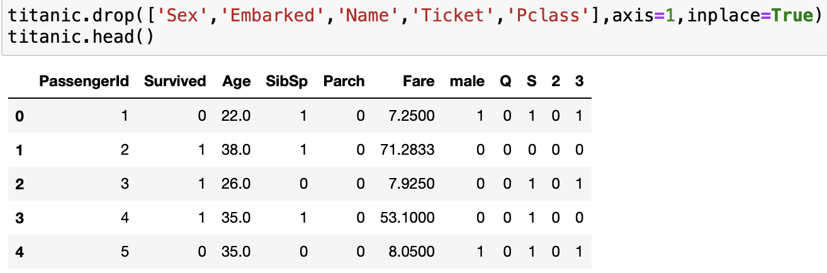
Data Preparation - Cleaning
08
Delete columns we will not use like 'Sex', 'Embarked', 'Name’, 'Ticket’ , and ’Pclass’ columns
'Now we don't need the 'Embarked' column since we already encoded it as Q and S and we don't need the 'Sex' column since we encoded it with the male column.
We don't need the 'Name' and 'Ticket' columns since we don't have enough information there for us to use for machine learning.
Notes:
Delete columns we will not use like 'Embarked', 'Sex', 'Name', and 'Ticket' columns . 'Now we don't need the 'Embarked' column since we already encoded it as Q and S and we don't need the 'Sex' column since we encoded it with the male column. We don't need the 'Name' and 'Ticket' columns since we don't have enough information there for us to use for machine learning.

Slide 23
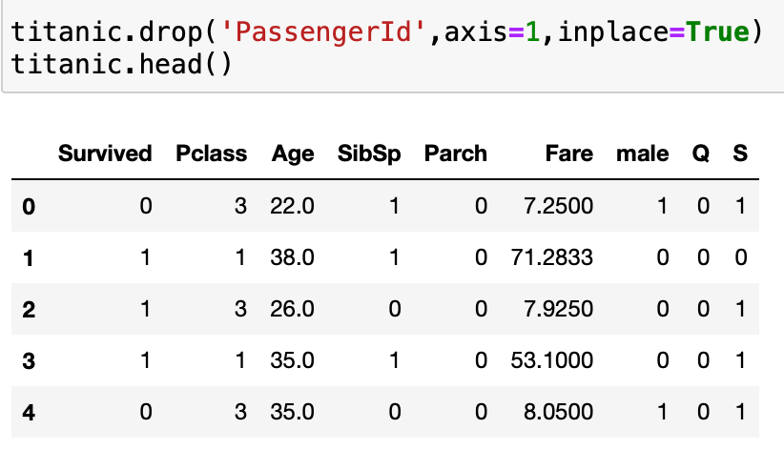

Data Preparation - Cleaning
10
We don't need 'PassengerId' since it is essentially an index that starts at 1.
Our data is now ready for a machine learning algorithm. All the data is numerical and everything is concatenated together.
Notes:
We don't need 'PassengerId' since it is essentially an index that starts at 1. Our data is now ready for a machine learning algorithm. All the data is numerical and everything is concatenated together.

Slide 24
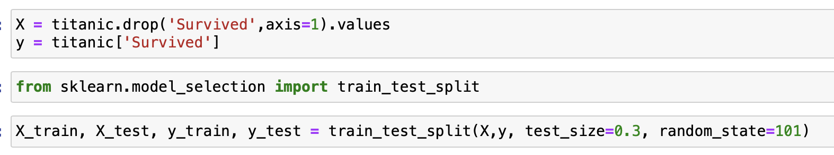
Data Modeling
Dataset Setup

Slide 25
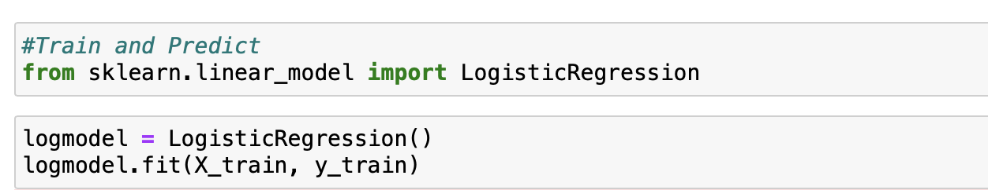
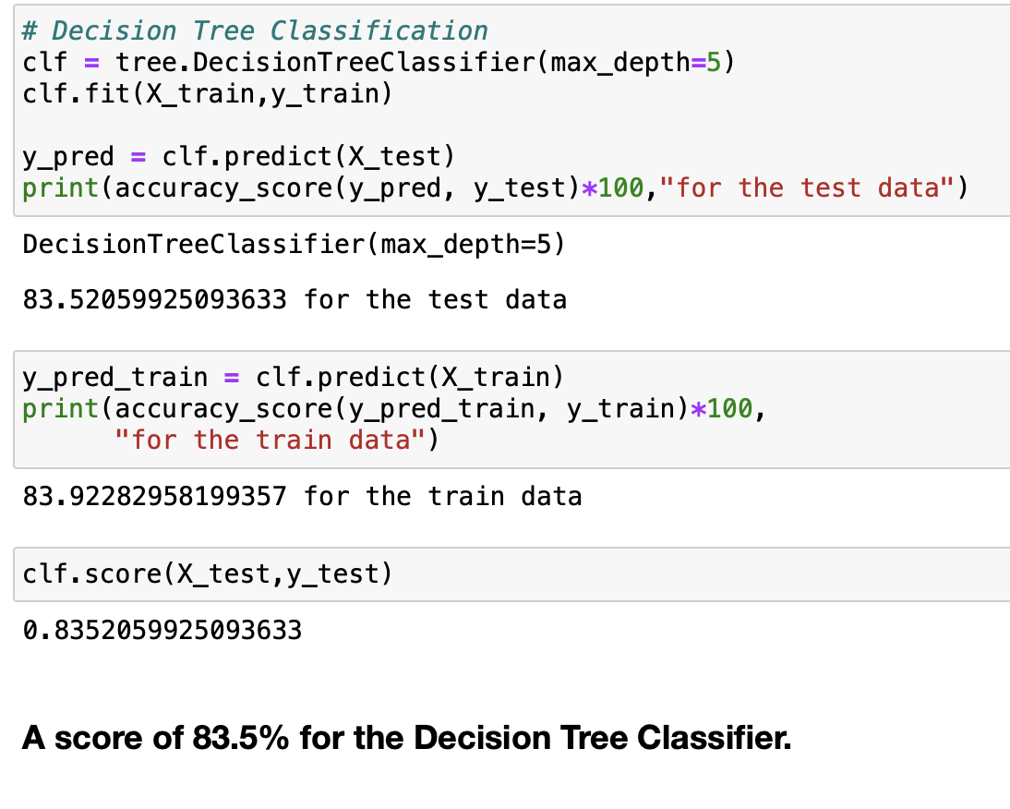
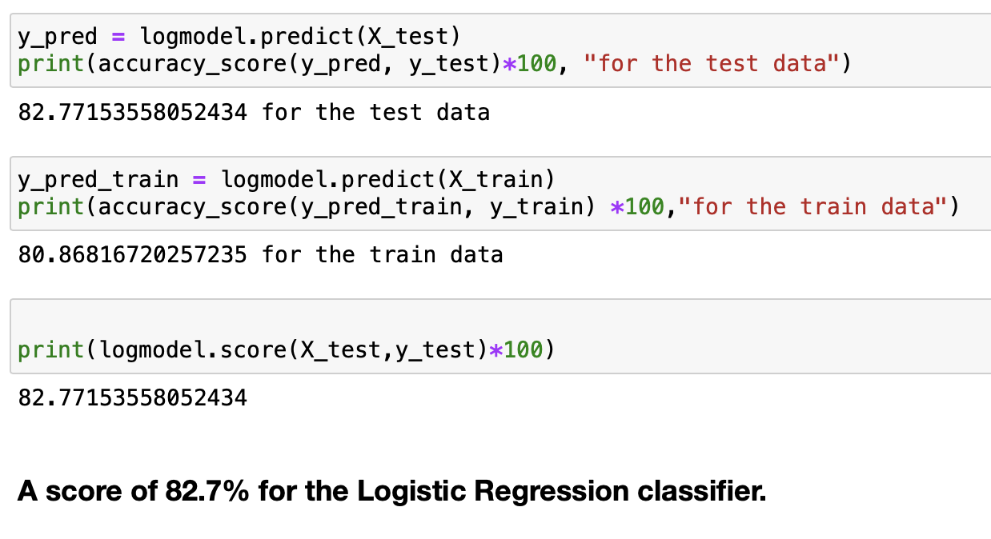
Data Modeling
We used two models:
Logistic Regression
Decision Tree Classifier

Slide 26
Data Modeling
Logistic Regression returned 83% for the test data, and 81% for the train data, with an overall score of 83%.
Decision Tree Classifier returned 84% for the test data, and 84% for the train data, with an overall score of 84%.

Slide 27
Conclusion
After testing two models: Logistic Regression model which is a binary classifier, and and Decision Tree Classifier, we found the following results:
The Logistic Regression model returned an accuracy score of 83% while Decision Tree Classifier returned an accuracy score of 84%.
We can conclude that the Decision Tree Classifier performed better because it shows no variation in the test and train data accuracy and shows a higher accuracy score.

Slide 28
What group of people most likely survived the shipwreck?
If you were a female or a child in the 1st or 2nd class cabins, you most likely survived the shipwreck.
To find out the accuracies of the Titanic movie.
The Titanic movie was shown as the most chivalrous which is backed with the data exploration from previous slides when it showed most females and children survived compared to males.

